Slide 1

introduction .The Next Evolution in Fighting Games .Released: June 2, 2023 .platforms: PS4, PS5, Xbox Series X|S, PC, Arcade .Developer: Capcom

Slide 2

Game Modes
Three Core Game Modes:
Fighting Ground: Traditional 2D battles, training, and arcade modes
World Tour: Single-player story mode with a customizable avatar exploring 3D environments
Battle Hub: Online lobby featuring ranked matches, casual play, and classic Capcom arcade games

Slide 3
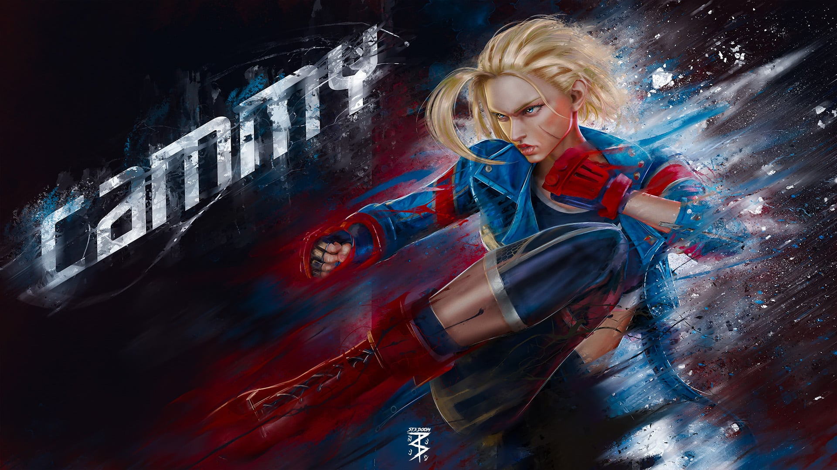
New Features
Innovative Gameplay Mechanics:
Drive Gauge: Resource system for advanced techniques like Drive Impact, Drive Rush, and Drive Parry
Control Options: Classic, Modern, and Dynamic schemes to cater to all skill levels
Real-Time Commentary: Live play-by-play and color commentary during matches

Slide 4
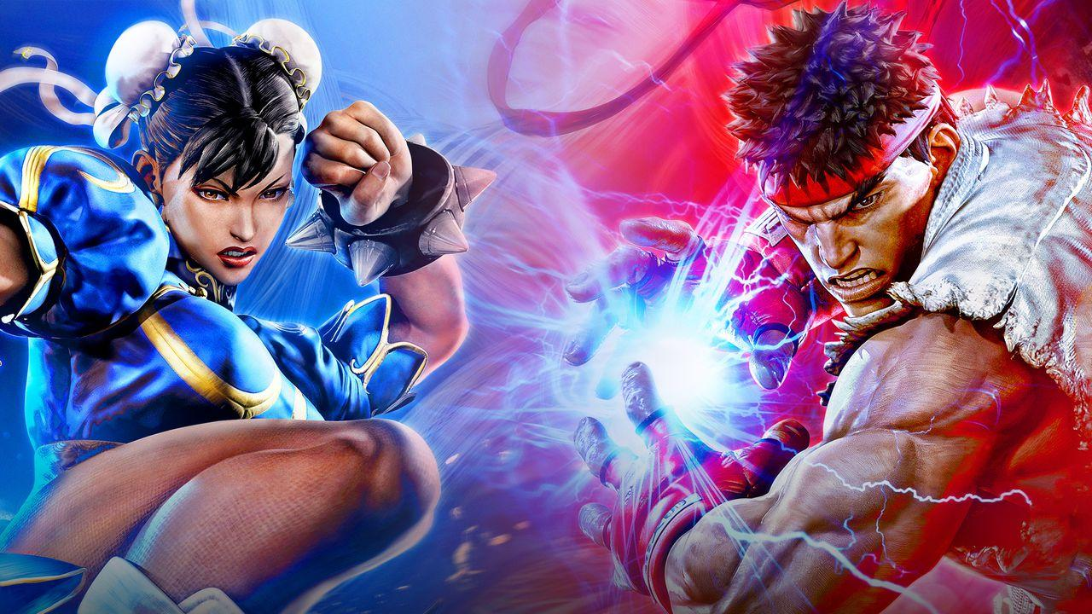
Character Roster
Launch Roster:
18 characters including Ryu, Chun-Li, Ken, Luke, and Zangief New Additions:
Season 1: Rashid, Ed, Akuma
Season 2: M. Bison, Elena, Terry Bogard, Mai Shiranui

Slide 5

Accessibility & Inclusivity
Enhanced Accessibility Features:
Modern Controls: Simplified inputs for newcomers
Audio Cues: Improved sound indicators for blind and low-vision players
Inclusive Voice Acting: Chun-Li voiced by Jennie Kwan, marking a first for an Asian American actress in the role

Slide 6
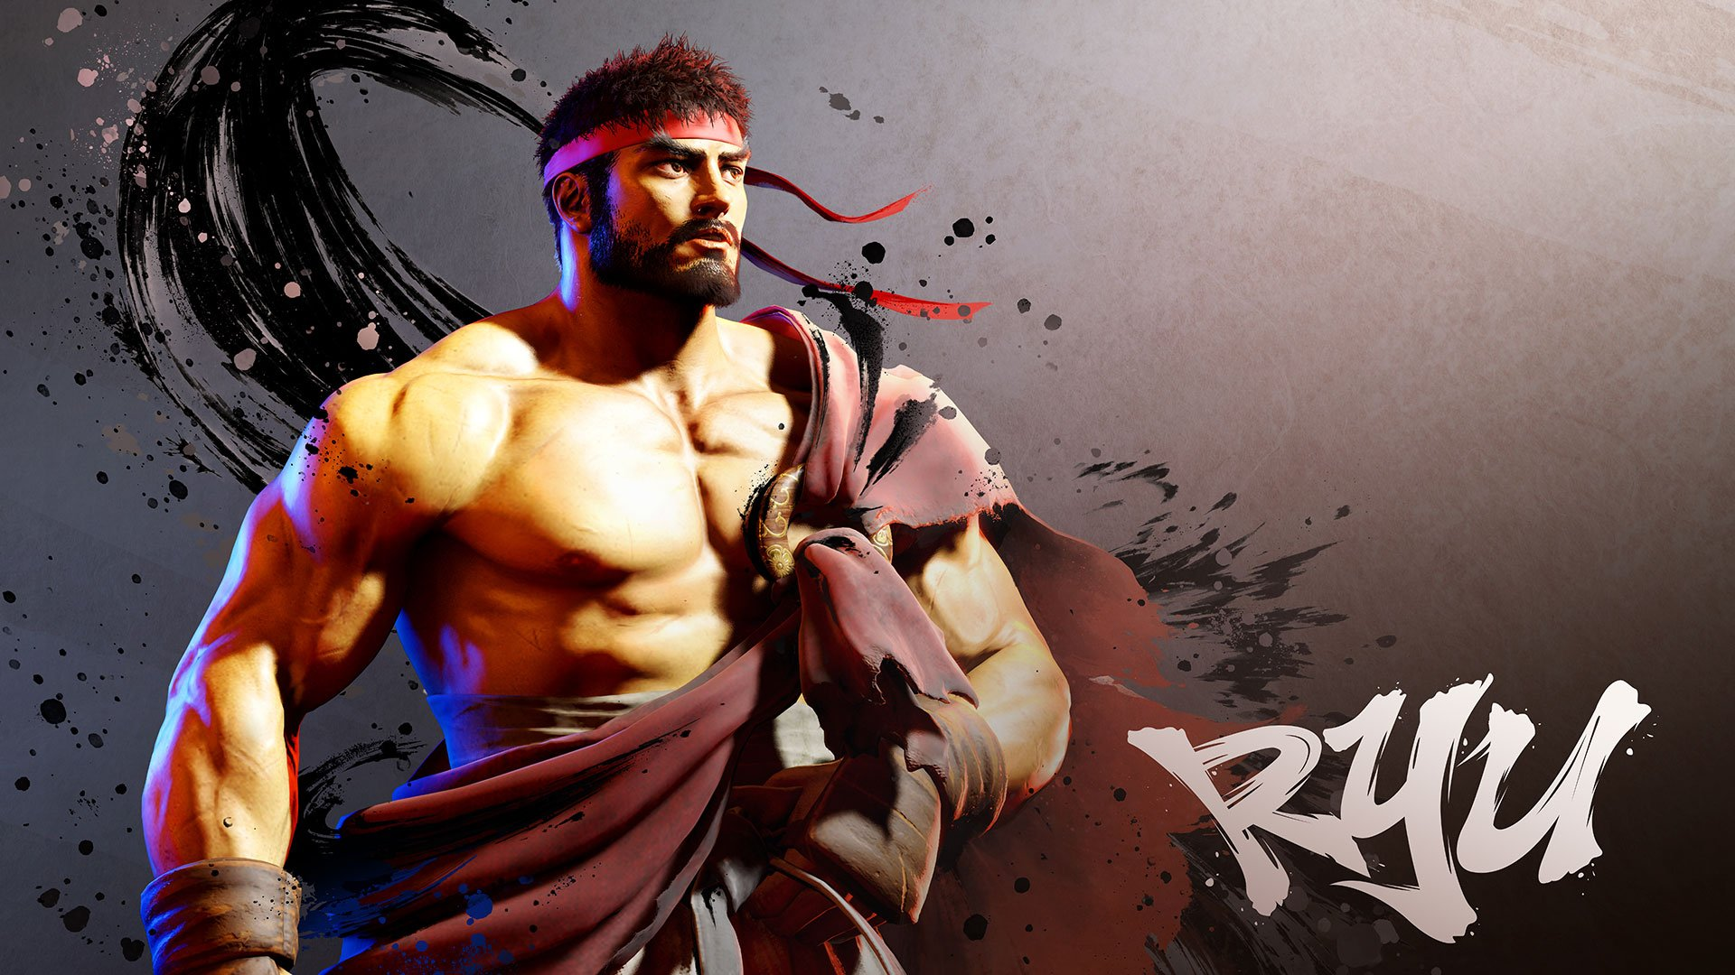
Reception & Awards
Critical Acclaim:
Over 4.4 million units sold by December 2024
Won "Best Fighting Game" at The Game Awards 2023
Won "Fighting Game of the Year" at the 27th Annual D.I.C.E. Awards

Slide 7
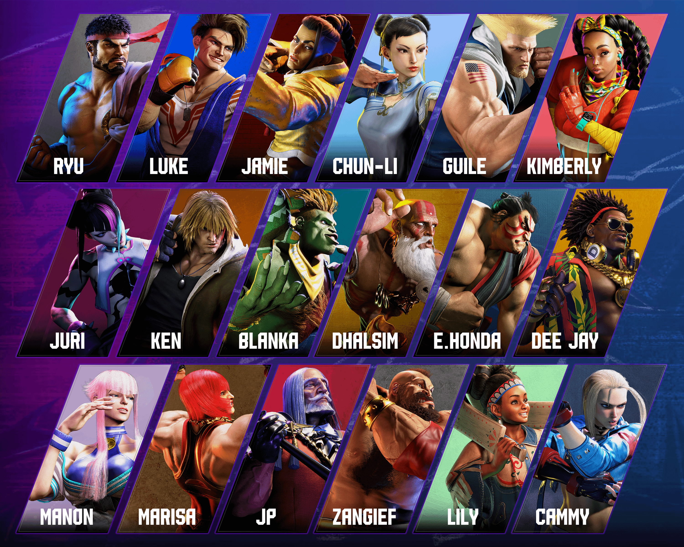
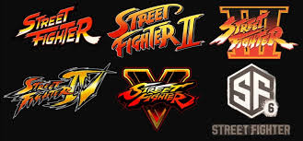
Upcoming Content
Years 1-2 Fighters Edition:
Releases June 5, 2025
Includes all DLC characters up to Season 2
Available on PS5, PS4, Xbox Series X|S, PC, and Nintendo Switch 2

